Slide 1

COMP90018
Mobile Computing Systems Programming
WEEK 5 – Data Storage
Weiwei Jiang
weiwei.jiang@student.unimelb.edu.au

Slide 2
1
2
3
Data Storage
SharedPreferences
SQLite
4
5
6
File Storage
Content Provider
Cloud Platform
(next tutorial)
CONTENTS

Slide 3

Data Storage

Slide 4
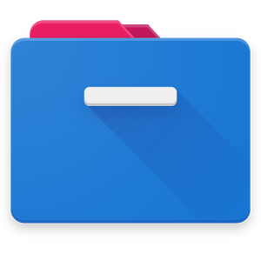
Data Storage
When building mobile applications you will often need to store persistent data on the device itself.
This type of storage allows your applications to
function effectively when there is no connection (offline);
offering more advanced and often faster functionality than server side storage only (cache).

Slide 5
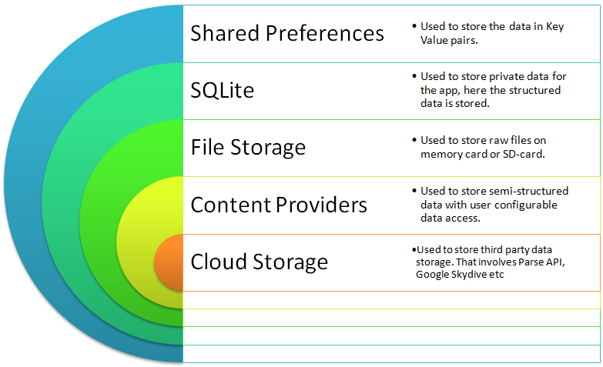
Data Storage
Android provides several options for you to save your app data:
SharedPreferences;
SQLite;
File Storage;
Content Provider;
Cloud Storage;
…

Slide 6
SharedPreferences

Slide 7
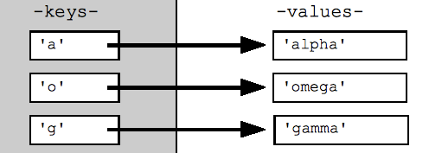
SharedPreferences
If you have a relatively small collection of key-values that you'd like to save, you should use the SharedPreferences APIs.
For example: your app settings.
https://developer.android.com/training/data-storage/shared-preferences

Slide 8
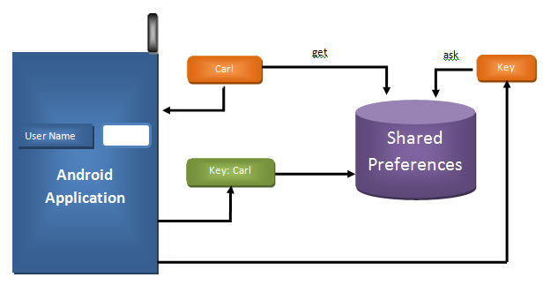
SharedPreferences
A SharedPreferences object points to a file containing key-value pairs and provides simple methods to read and write them.
Each SharedPreferences file is managed by the framework and can be private or shared.

Slide 9


SharedPreferences – Code
Save
Load

Slide 10
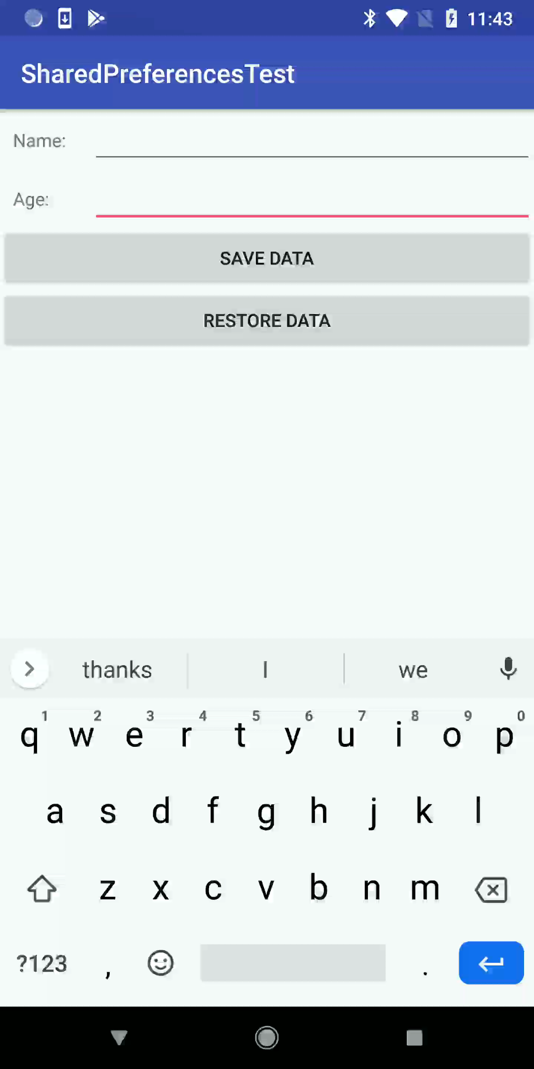
SharedPreferences – Demonstration

Slide 11
SQLite

Slide 12

Android and SQLite
Android provides full support for SQLite databases.
Can be used for structured data storage.
Note:
Any database you create is only accessible by your app.
Share data using content provider.
https://developer.android.com/guide/topics/data/data-storage#db

Slide 13

For Reading – SQLite
SQLite is a C-language library that implements a small, fast, self-contained, high-reliability, full-featured, SQL database engine.
SQLite is the most used database engine in the world. SQLite is built into all mobile phones and most computers and comes bundled inside countless other applications that people use every day.
https://www.sqlite.org/index.html

Slide 14
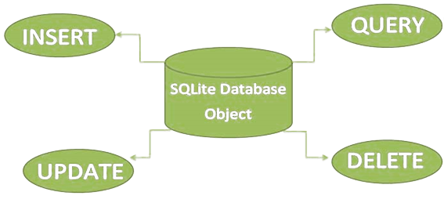
SQLite
Saving data to a database is ideal for repeating or structured data, such as contact information.
SQLite can perform the operations of insert, query, update and delete as other relational database.
https://developer.android.com/training/data-storage/sqlite.html

Slide 15
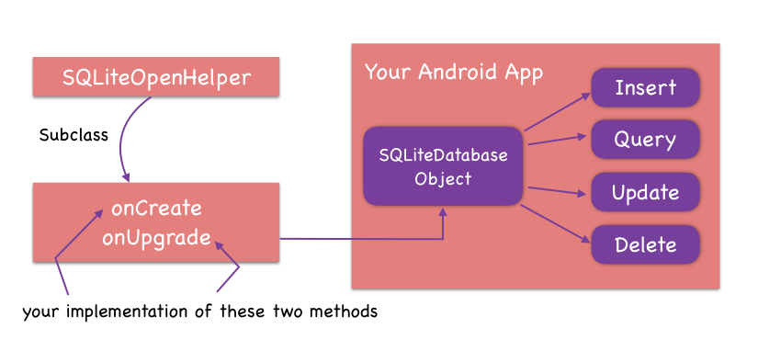
SQLiteOpenHelper
When creating and maintaining database and tables, SQLiteOpenHelper class contains a useful set of APIs for managing your database.
All you need to do is call getWritableDatabase() or getReadableDatabase().
https://developer.android.com/reference/android/database/sqlite/SQLiteOpenHelper.html

Slide 16
SQLite
Create a Database

Slide 17
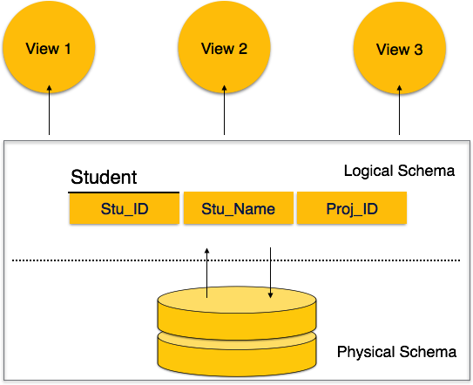
Define a Schema
One of the main principles of SQL databases is the schema: a formal declaration of how the database is organized.
The schema is reflected in the SQL statements that you use to create your database.

Slide 18
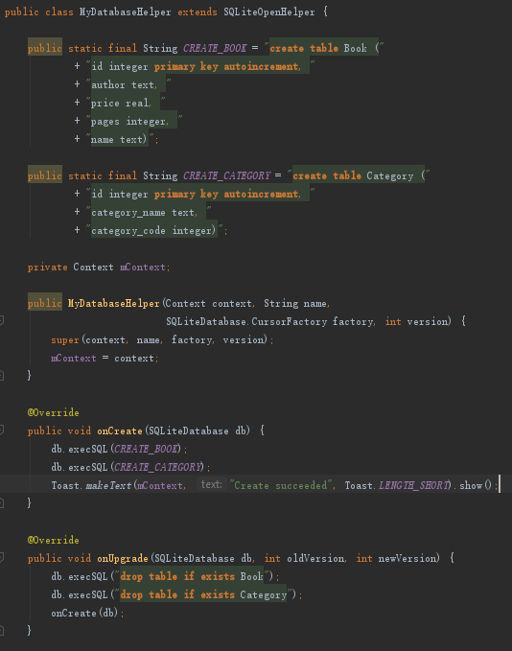
Extend SQLiteOpenHelper
Create a subclass that overrides the onCreate() and onUpgrade() callback methods.

Slide 19
Hold the instance of SQLiteOpenHelper
Get writable database
via the instance of SQLiteOpenHelper
Hold a instance of SQLiteOpenHelper

Slide 20
Execute the defined onCreate() method
When the database does not exist, the instance of SQLiteOpenHelper will create a database according to onCreate() method.

Slide 21
SQLite
CRUD

Slide 22
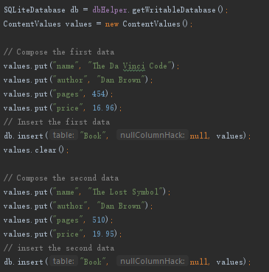
Insert Data
Insert data into the database by passing a ContentValues object to the insert() method.

Slide 23
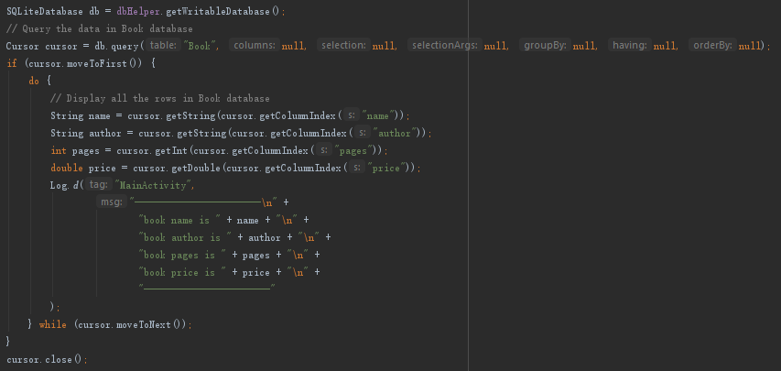
Query Data
To read from a database, use the query() method, passing it your selection criteria and desired columns.

Slide 24

Update Data
When you need to modify a subset of your database values, use the update() method.

Slide 25
Delete Data
To delete rows from a table, you need to provide selection criteria that identify the rows to the delete() method.

Slide 26
SQLite
Reading material: greenDao

Slide 27

For Reading – greenDao
greenDAO is an open source Android ORM (Object-Relational Mapping) making development for SQLite databases fun again.
http://greenrobot.org/greendao/
http://greenrobot.org/greendao/documentation/

Slide 28
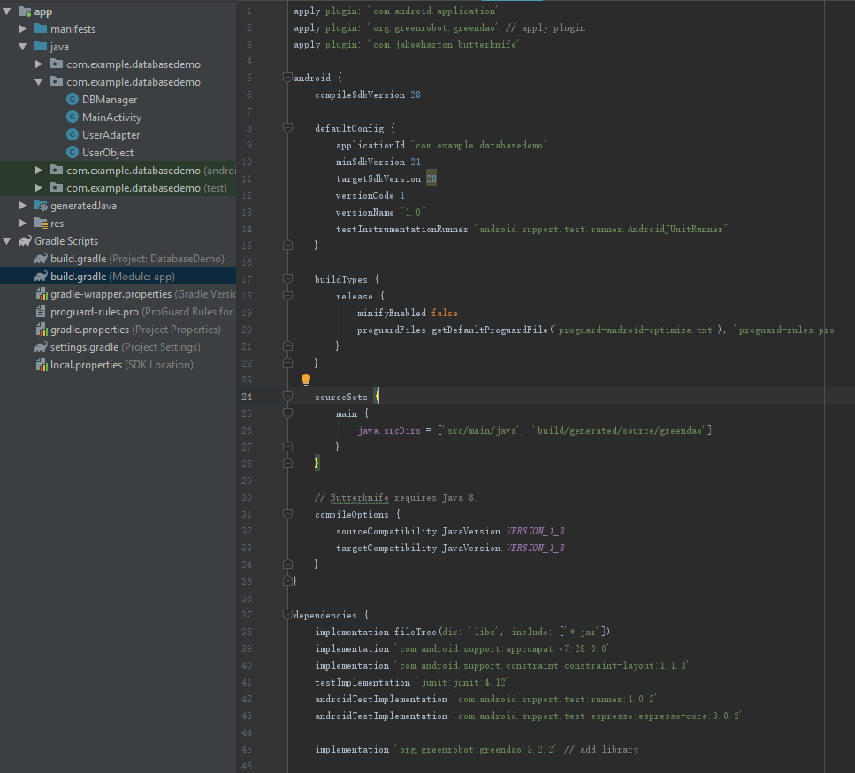
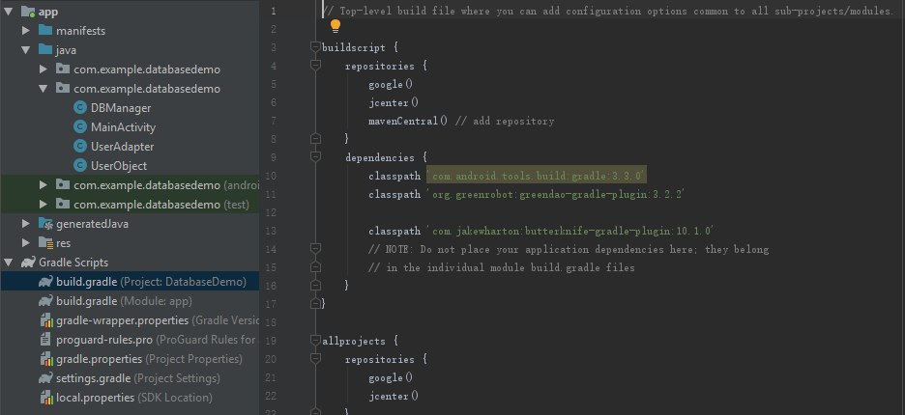
greenDao – Add greenDao to your project
build.gradle(project level)
build.gradle(app level)

Slide 29
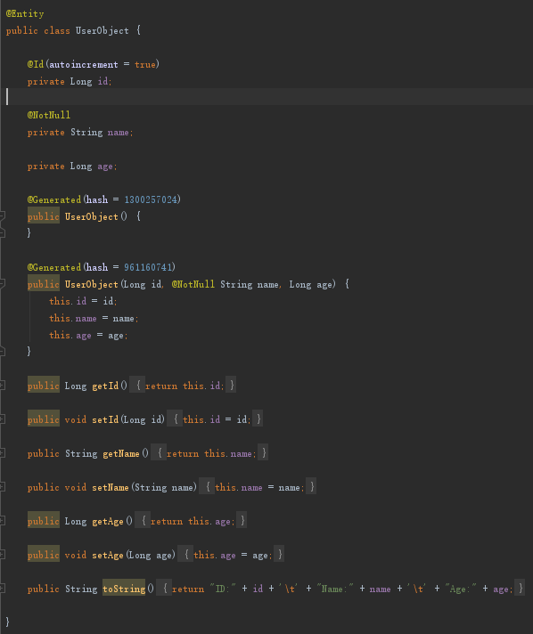
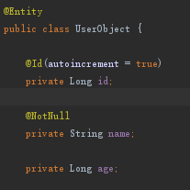
greenDao – Create Entity class
UserObject.java
UserObject.java(automatic generated)

Slide 30
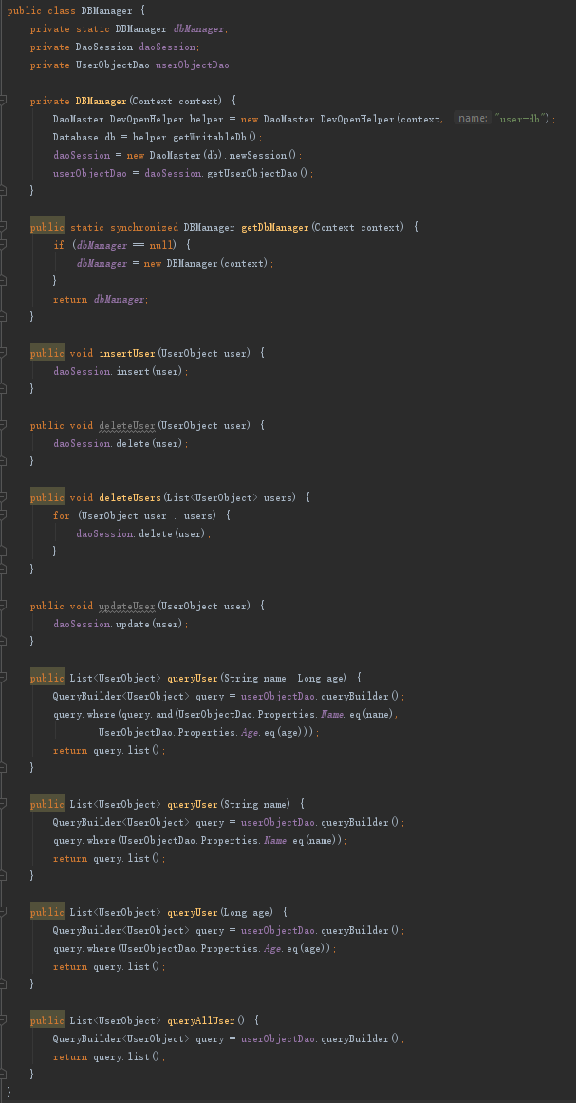
greenDao – Create DBManager class
Create DBManager class to encapsulate CRUD methods and obtain the instances of DaoSession, DaoMaster, etc..
DBManager.java

Slide 31
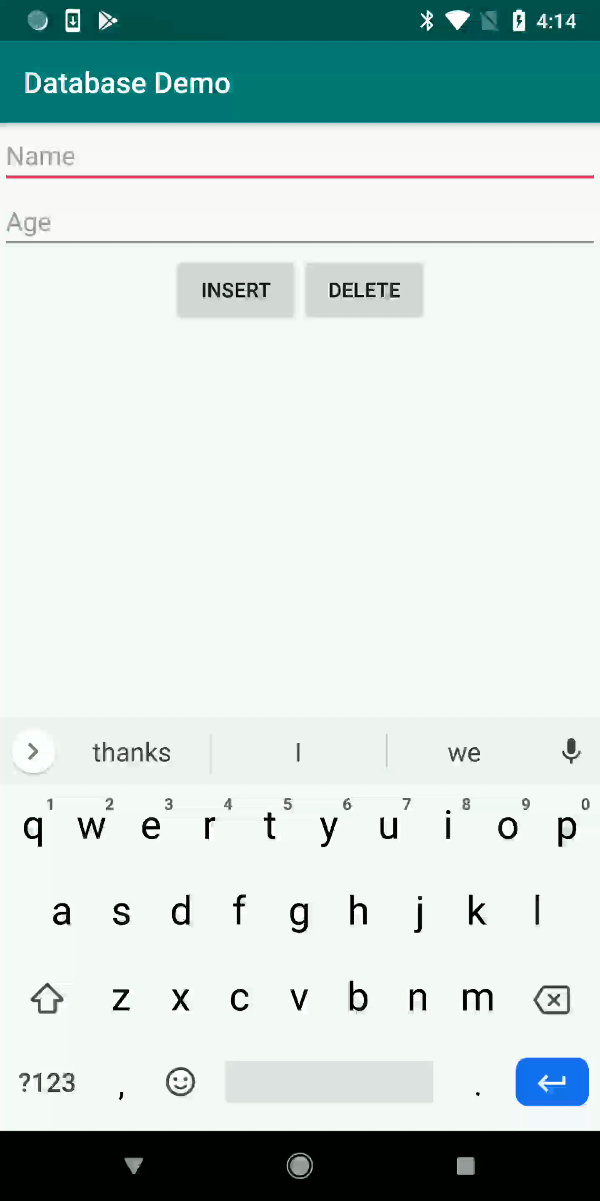
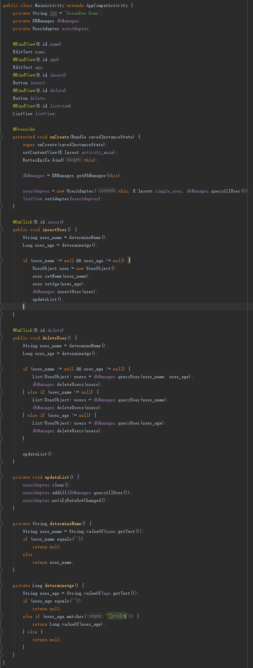
greenDao – Control database through DBManager
MainActivity.java

Slide 32
File Storage

Slide 33
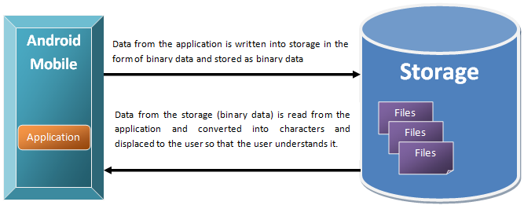
File Storage
Android uses a file system that's similar to disk-based file systems (like your computer’s OS).
https://developer.android.com/training/data-storage/files.html

Slide 34
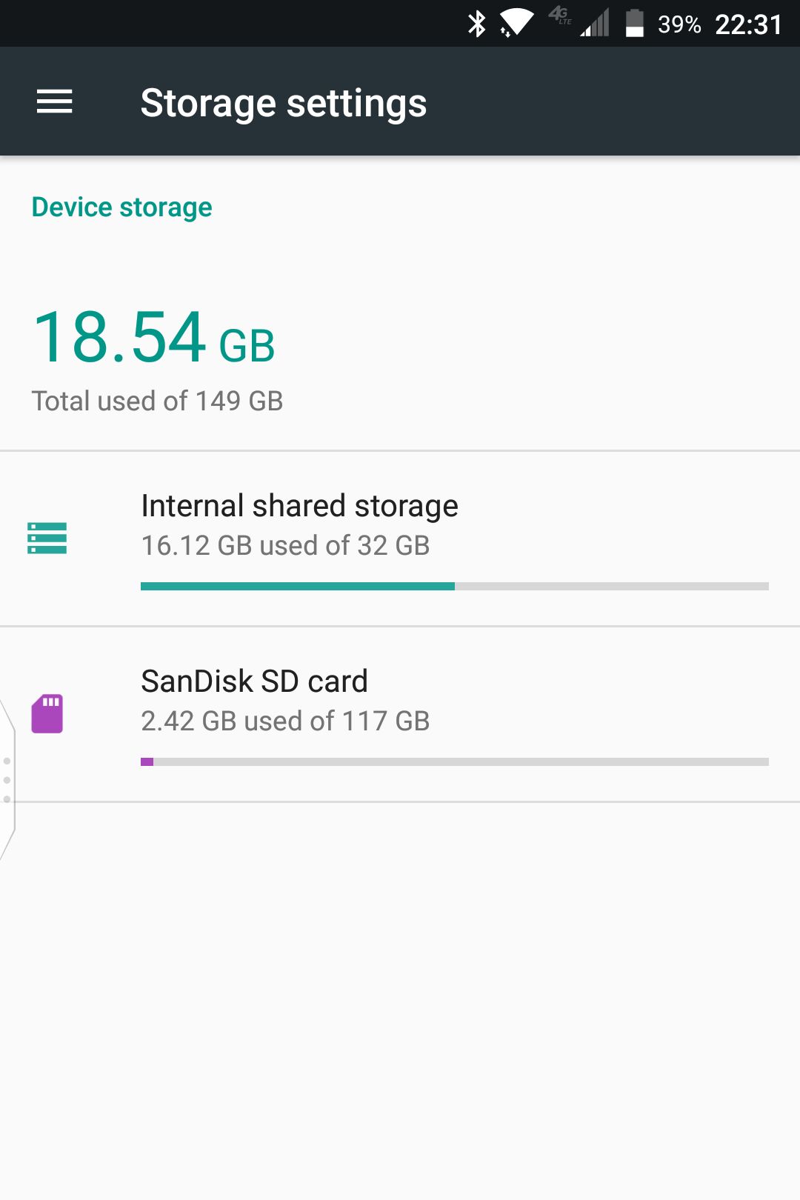
Internal and External Storage
All Android devices have two file storage areas: "internal" and "external" storage. These names come from the early days of Android, when most devices offered built-in non-volatile memory (internal storage), plus a removable storage medium such as a micro SD card (external storage).

Slide 35
Internal and External Storage
Many devices now divide the permanent storage space into separate "internal" and "external" partitions.
So even without a removable storage medium, these two storage spaces always exist, and the API behavior is the same regardless of whether the external storage is removable.

Slide 36
Internal and External Storage
Internal storage
It's always available.
Files saved here are accessible by only your app.
When the user uninstalls your app, the system removes all your app's files from internal storage.

Slide 37
Internal and External Storage
External storage
It's not always available, because the user can mount the external storage as USB storage and in some cases remove it from the device.
It's world-readable, so files saved here may be read outside of your control.
When the user uninstalls your app, the system removes your app's files from here only if you save them in the directory from getExternalFilesDir().

Slide 38
Internal and External Storage
Internal storage is best when you want to be sure that neither the user nor other apps can access your files.
External storage is the best place for files that don't require access restrictions and for files that you want to share with other apps or allow the user to access with a computer.

Slide 39
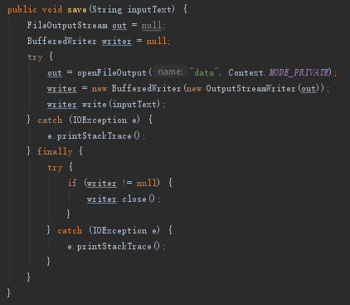
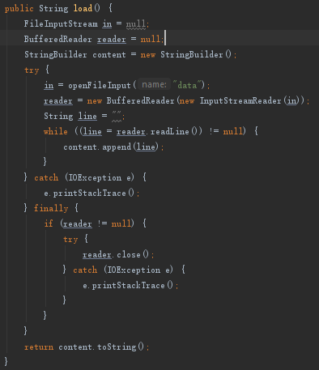
Internal Storage Demonstration
Save
Load

Slide 40
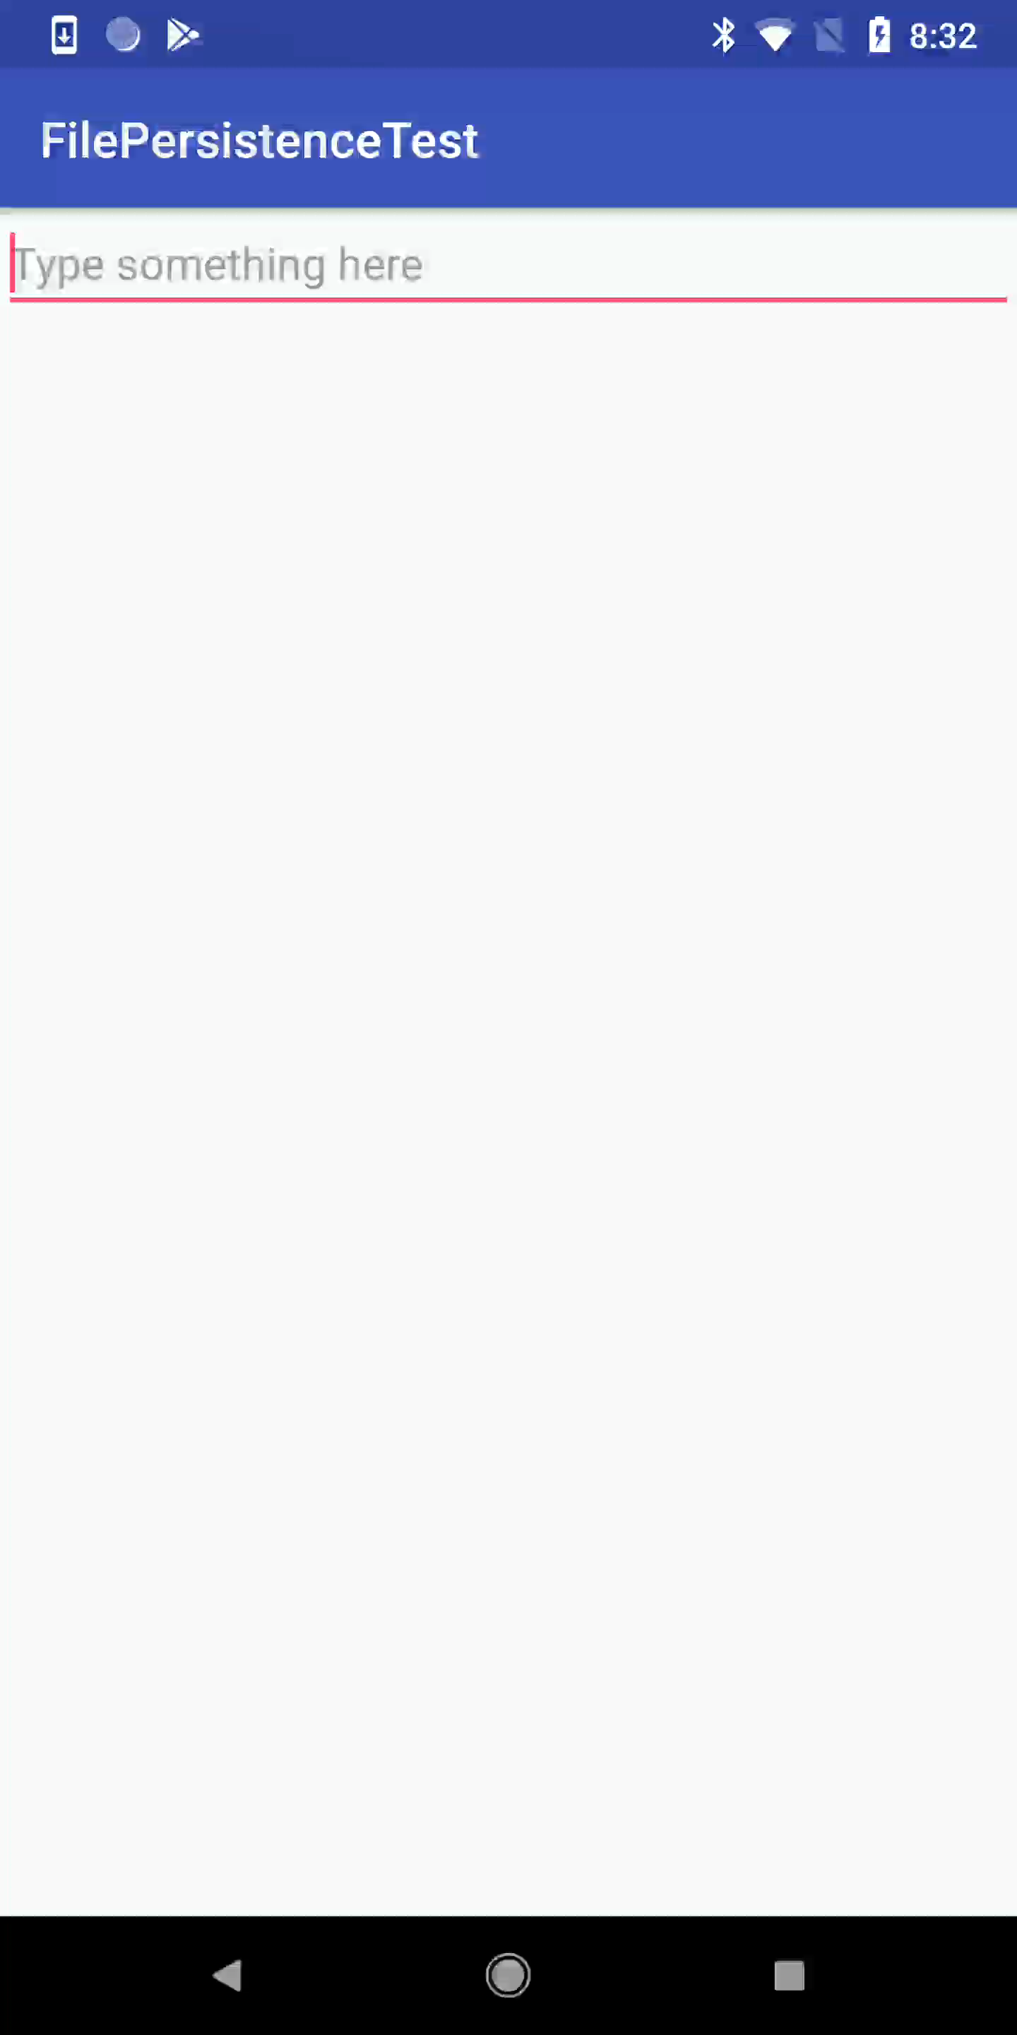
Internal Storage Demonstration

Slide 41
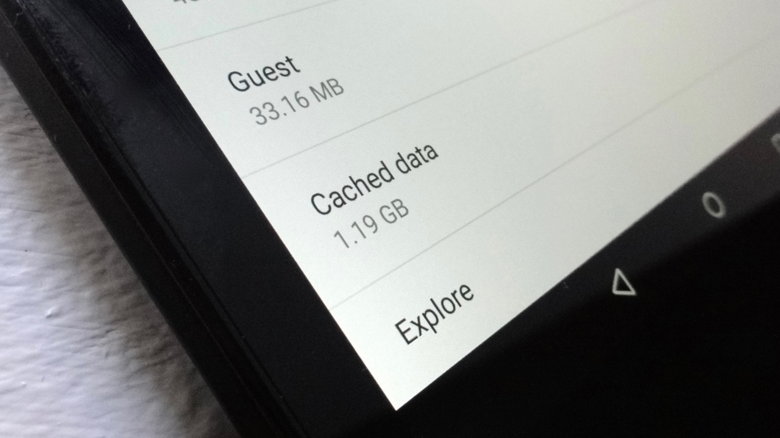
Cached File
If you'd like to keep some data temporarily, rather than store it persistently, you should use the special cache directory to save the data. Each app has a private cache directory specifically for these kinds of files.
https://developer.android.com/guide/topics/data/data-storage#InternalCache

Slide 42

Cached File
When the device is low on internal storage space, Android may delete these cache files to recover space.

Slide 43
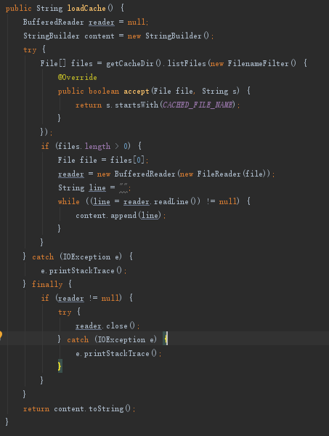
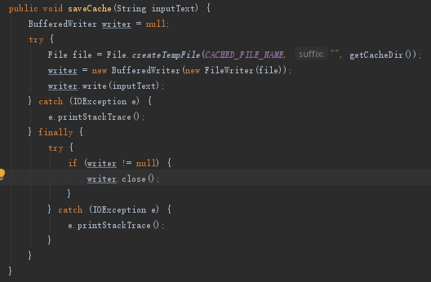
Cached File
Load
Save

Slide 44
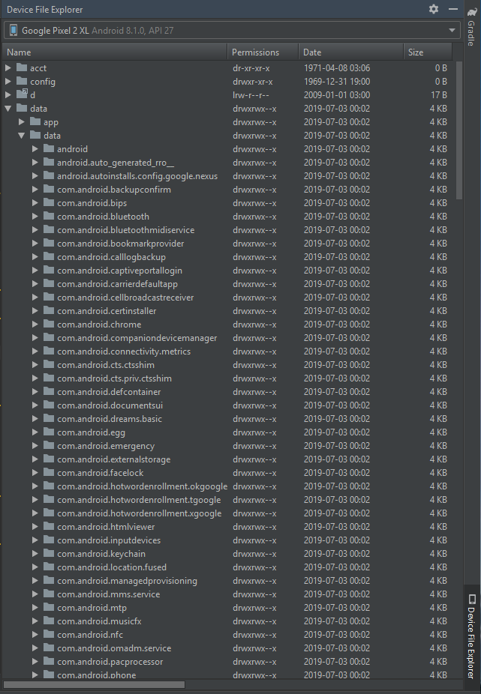
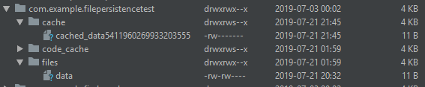
Find File through Android Studio

Slide 45
Content Provider

Slide 46
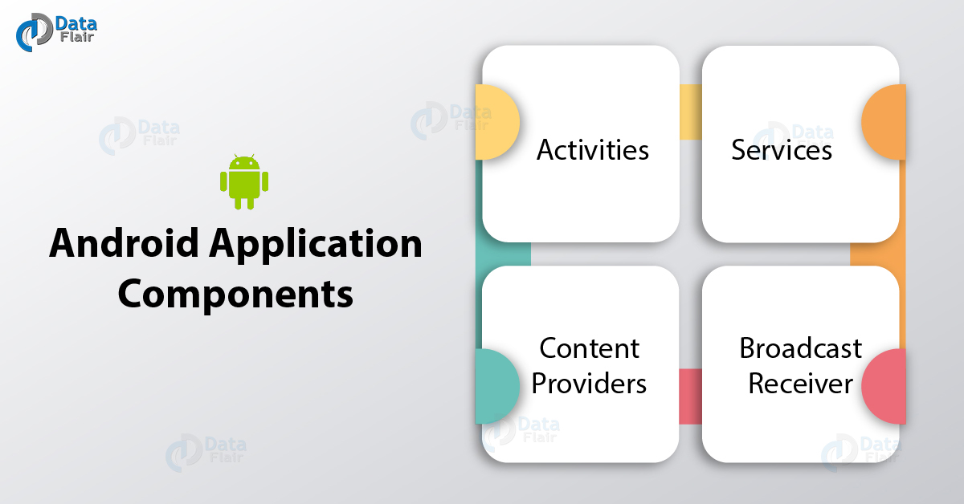
Content Provider
Content Provider is a component of an Android application.
https://developer.android.com/guide/topics/providers/content-provider-basics

Slide 47
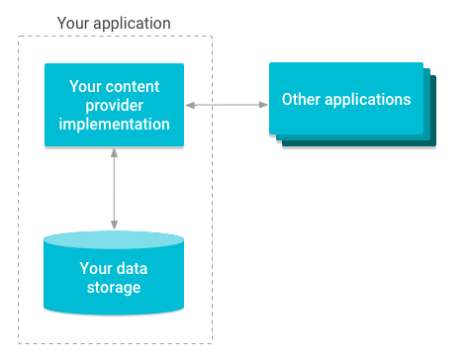
Content Provider
Content providers are primarily intended to be used by other applications, which access the provider using a provider client object.
Providers and provider clients offer a consistent, standard interface to data that also handles inter-process communication(IPC) and secure data access.

Slide 48
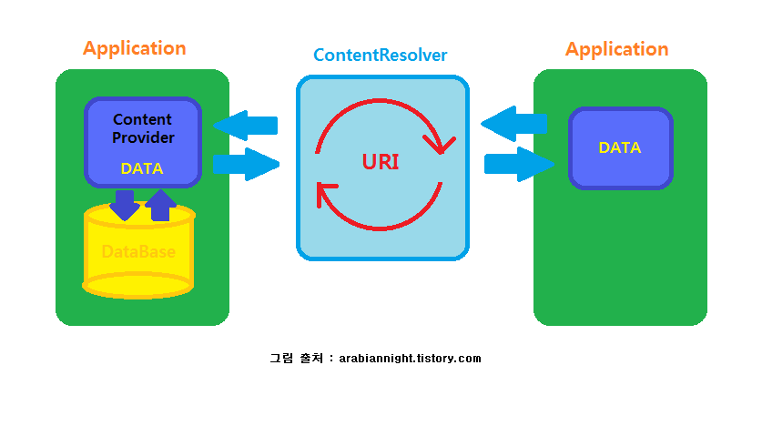
Access data through a Content Provider

Slide 49
URI (Uniform Resource Identifier)
- URI is like URL (a web link), but not exactly the same.
To query a content provider, you specify the query string in the form of a URI which has following format:
content://<authority>/<data_type>/<id>
This specifies the name of the content provider, like com.example.datatest.provider.
Name of database table that this particular provider provides.
Specific record requested (optional).

Slide 50
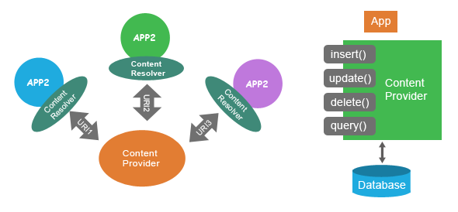
Content Provider
The Content Provider is required to provide the basic "CRUD" (create, retrieve, update, and delete) functions of persistent storage.

Slide 51
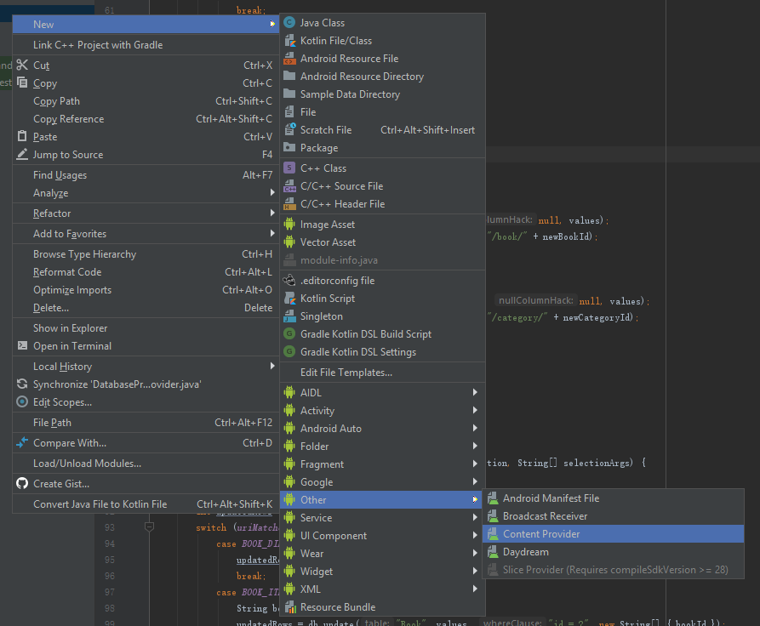
Content Provider – Create

Slide 52
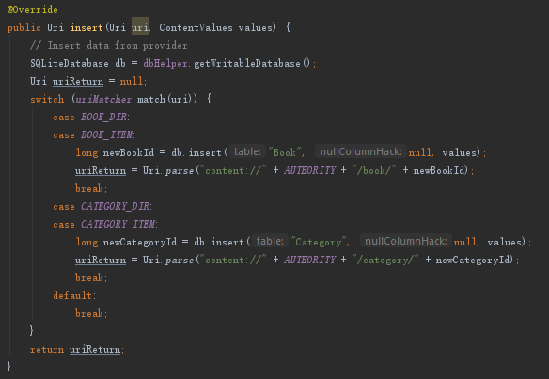
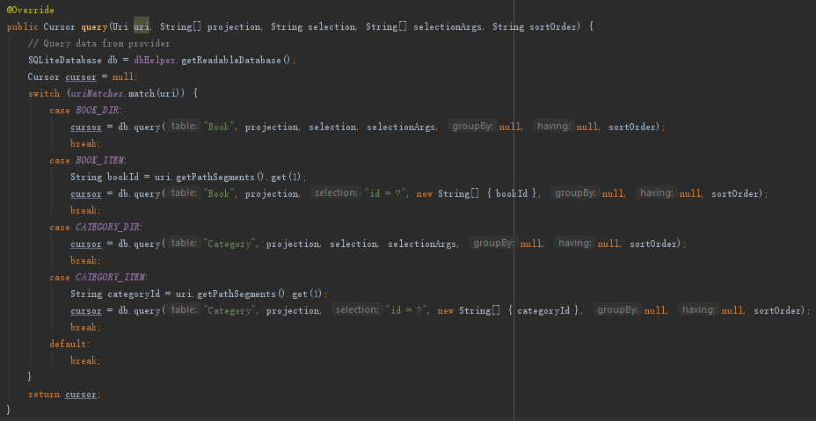
Content Provider – Overwrite methods
Create - Insert
Read - Query

Slide 53
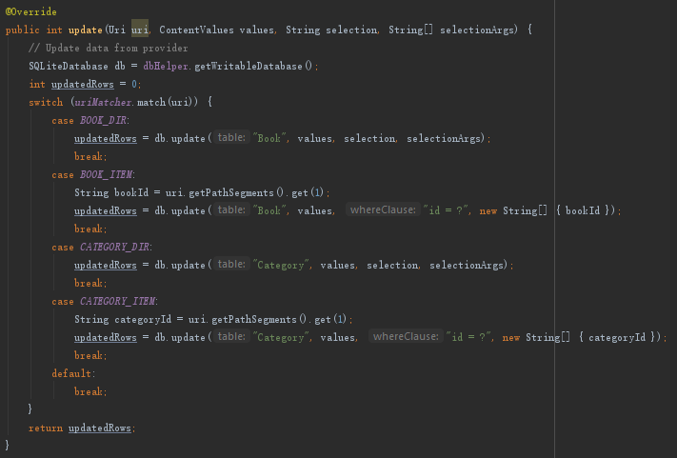
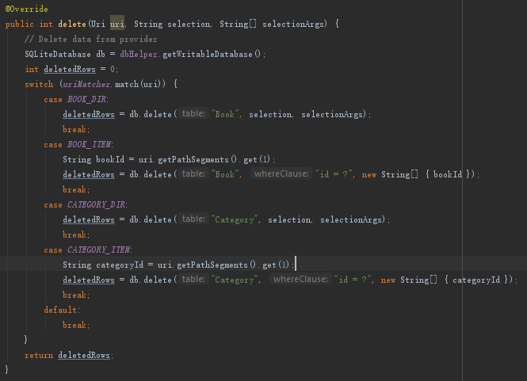
Content Provider – Overwrite methods
Update
Delete

Slide 54
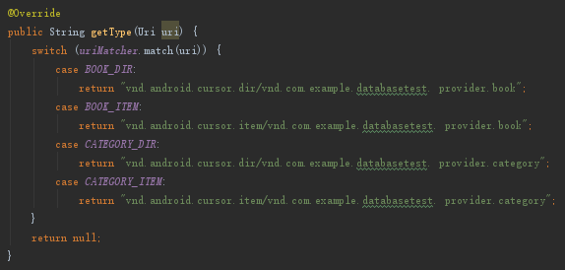
Content Provider – Overwrite methods
Providers need to maintain MIME data type information for each content URI they define.
You can use the MIME type information to:
find out if your application can handle data that the provider offers,
choose a type of handling based on the MIME type.
https://developer.android.com/guide/topics/providers/content-provider-basics#MIMETypeReference
getType()

Slide 55
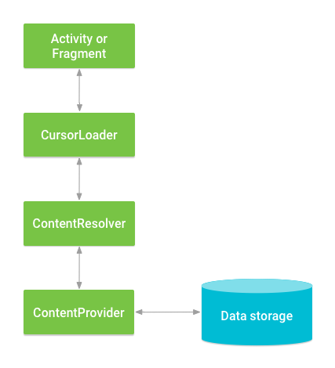
ContentResolver – Client of ContentProvider
When you want to access data in a content provider, you use the ContentResolver object in your application's Context to communicate with the provider as a client.
https://developer.android.com/reference/android/content/ContentResolver.html

Slide 56
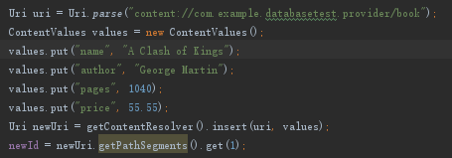
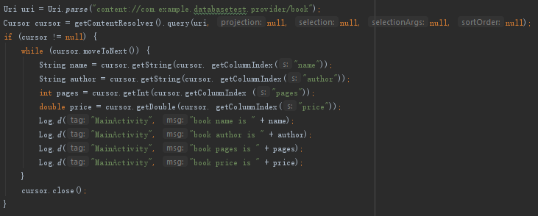
ContentResolver
Create – Insert from ContentResolver
Read – Query from ContentResolver

Slide 57
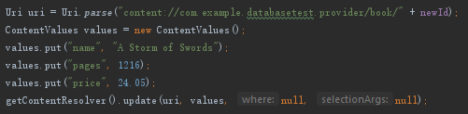
ContentResolver
Update from ContentResolver
Delete from ContentResolver

Slide 58
Cloud Platform

Slide 59
Cloud Platform
Modern technologies like big data analytics, IoT, artificial intelligence, web and mobile app hosting all need heavy computing power.
Instead of building your own backend services, cloud platforms help you build and manage mobile applications through their cloud service, including authentication, database, image storage, etc.
https://en.wikipedia.org/wiki/Category:Cloud_platforms

Slide 60
Cloud Platform – Firebase
In the next tutorial, we will use Firebase to develop a demonstration application.

Slide 61
If you come for the tutorial starting at 2pm,
please rejoin the zoom meeting after this call ends.

